Slide 1
Discourse Mode Identification in Essays
Wei Song
Capital Normal University
Cooperating with Dong Wang, Ruiji Fu, Lizhen Liu,
Ting Liu, Guoping Hu
IFLYTEK Research and Harbin Institute of Technology

Slide 2
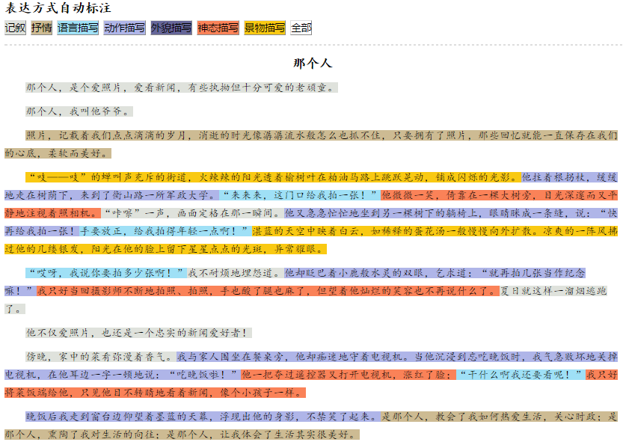

Slide 3
Outline
Discourse Modes
Data Annotation
Discourse Mode Identification
Essay Scoring with Discourse Modes
Conclusion

Slide 4
Outline
Discourse Modes
Data Annotation
Discourse Mode Identification
Essay Scoring with Discourse Modes
Conclusion

Slide 5
Discourse Modes
Discourse modes, also known as rhetorical modes, describe the purpose and conventions of the main kinds of language based communication
Several taxonomies of discourse moods in the literature

Slide 6
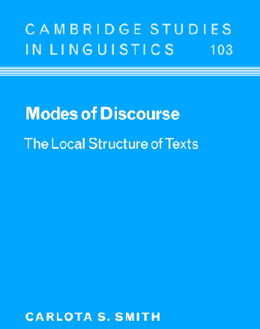
Taxonomies of Discourse Modes
Discourse modes by C. Smith, studying discourse passages from a linguistic view of point
Narration
Description
Argument
Information
Report

Slide 7
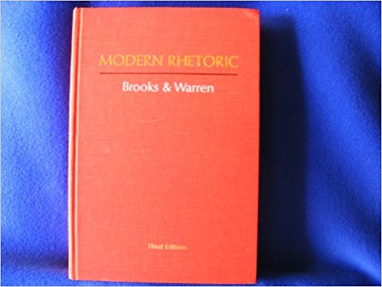
Taxonomies of Discourse Modes
Discourse modes in rhetoric
Narration
Description
Argumentation
Exposition

Slide 8

Taxonomies of Discourse Modes
Discourse modes in Chinese composition
Narration
Description
Argument
Exposition
Emotion Expressing

Slide 9
Functions of Discourse Modes in a text
Various discourse modes stand for unity of a text
Discourse modes can reflect the organization and progression of a text
Indicating the intention of writing a passage
Discourse modes have rhetorical significance
Preferring different expressive styles
Flexible use of multiple discourse modes

Slide 10
Research Questions
Discourse mode identification is a fundamental but less studied problem in NLP
Can we annotate a corpus with acceptable agreement?
Can discourse modes be identified automatically?
Can discourse mode identification help downstream NLP tasks

Slide 11
Outline
Discourse Modes
Data Annotation
Discourse Mode Identification
Essay Scoring with Discourse Modes
Conclusion

Slide 12
Discourse Modes in this work
We follow the Chinese convention
Narration is to introduce an event or series of events
Exposition is to explain or instruct or provide background information in narrative context
Description is to re-creates, invents, or vividly show what things are like
Argument is to make a point of view and prove its validity towards a topic
Emotion Expressing is to presents the writer’s motions, usually in a subjective, personal and lyrical way

Slide 13
Data
Collect 415 narrative essays written by high school students in native Chinese language
32 sentences and 670 words in average
Two annotators were asked to label discourse modes for each sentence
Each sentence can have more than one discourse mode, but a dominant mode should be informed

Slide 14
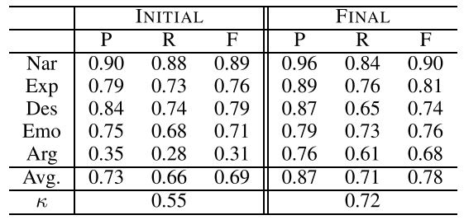
Inter-Annotator Agreement on the dominant mode
50 essays were annotated independently by two annotators
Measured by PRF and Kappa
Example: “父亲的爱是灯塔，引导我一生前进的路！”

Slide 15
Inter-Annotator Agreement on the dominant mode
50 essays were annotated independently by two annotators
Measured by PRF and Kappa

Slide 16
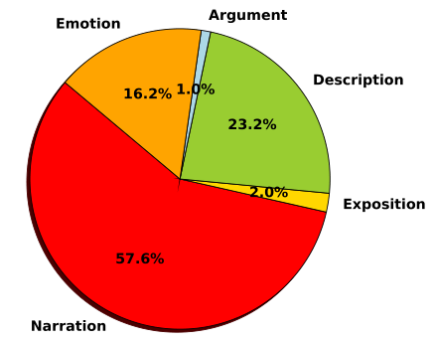
Distribution of Discourse Modes
Distribution is imbalanced

Slide 17
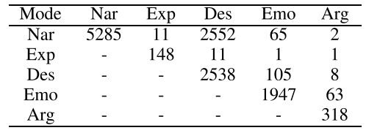
Co-Occurrence
22% sentences have more than one discourse modes
Description tends to co-occur with narration and emotion
Providing details of events
Evoking emotions
Emotion co-occurs with argument
Proper emotional appeals can enhance the strength of argument
海上生明月，天涯共此时。

Slide 18
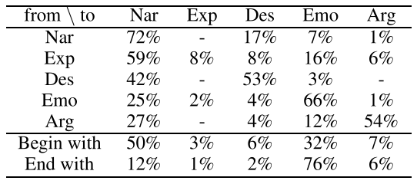
Transitions
Most modes tend to transit to themselves
Contextual information should be helpful

Slide 19
Summary
Annotators can achieve an acceptable agreement after training
About 22% sentences have more than one discourse mode
Distribution of discourse modes is imbalanced
Discourse modes have local transition patterns

Slide 20
Outline
Discourse Modes
Data Annotation
Discourse Mode Identification
Essay Scoring with Discourse Modes
Conclusion

Slide 21
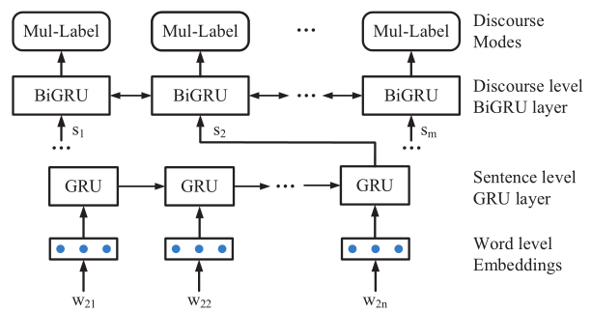
Discourse Mode Identification
We view it as a multi-label sequence labeling problem
Pre-trained Embeddings

Slide 22
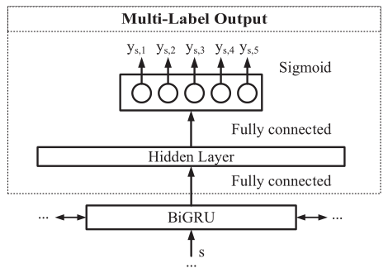
Discourse Mode Identification
Deal with multiple-Label outputs

Slide 23
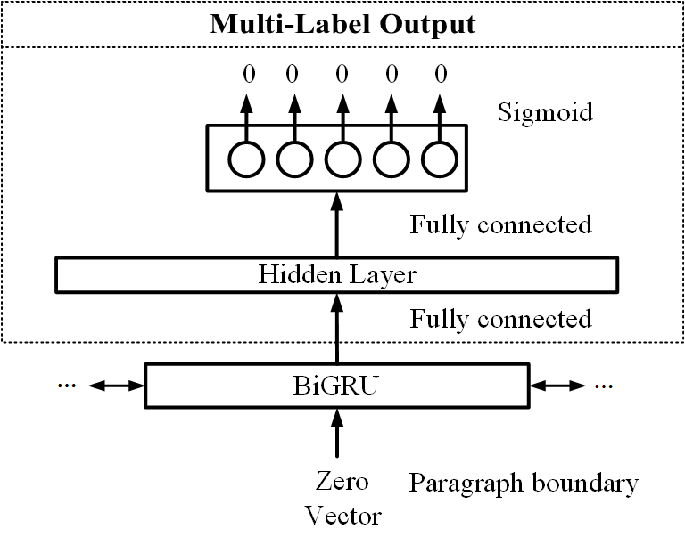
Discourse Mode Identification
Considering paragraph boundaries

Slide 24
Evaluation
Comparisons
SVM with unigram and bigram features
CNN (Kim et al. 2014)
GRU
GRU-GRU (GG): Our hierarchical model
GRU-GRU-SEG (GG-SEG): Consider paragraph boundaries on the top of GG

Slide 25
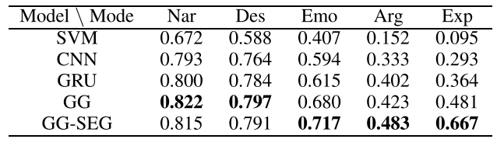
Evaluation
F1-score is reported
Neural models outperform bag-of-words method
RNN is slightly better than CNN
Sequence information is useful
Minority modes are more sensitive to positions
Overall average F1 is 0.7
Average F1 on three main modes is above 0.76

Slide 26
Outline
Discourse Modes
Data Annotation
Discourse Mode Identification
Essay Scoring with Discourse Modes
Conclusion

Slide 27
Automatic Essay Scoring (AES)
AES is the task of building a computer-aided scoring system, in order to reduce the involvement of human raters.
AES as a regression problem
Support Vector Regression
Bayesian linear ridge regression

Slide 28
Feature Sets
Basic features (Phandi et al. 2015)
Length features
Prompt features
Content features
Selected unigrams and bigrams
The number of Chinese idioms
The number of words in Chinese Proficiency Test 6 Dictionary
Discourse mode features
Discourse mode ratio
#sentence with the discourse mode / #sentences
Unigrams and bigrams of discourse mode sequences

Slide 29
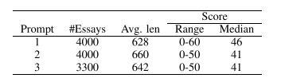
Data and Settings
Three prompts
Narrative essays written by junior school students in local tests
5-folds cross-validation
Evaluated with Quadratic Weighted Kappa (QWK)

Slide 30
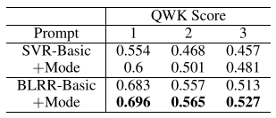
Evaluation
Overall performance
BLRR performs better
Discourse mode features are useful

Slide 31
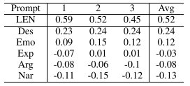
Evaluation
Pearson correlation coefficient between discourse mode ratio and scores
Narration has a negative correlation
Description is most relevant
Emotion expressing has a weak correlation

Slide 32
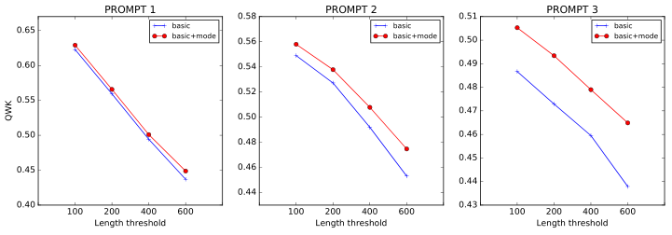
Evaluation
Performance on essays with different length
When the effect of length becomes weaker, AES becomes harder
In hard cases, the role of discourse mode features becomes more important

Slide 33
Outline
Discourse Modes
Data Annotation
Discourse Mode Identification
Essay Scoring with Discourse Modes
Conclusion

Slide 34
Conclusion
We have studied a fundamental but less studied problem in NLP
Both manual and automatic discourse mode identification is feasible
Discourse mode features are shown useful for automatic essay scoring
Discourse mode identification can support other downstream NLP applications potentially

Slide 35
Thank you

Slide 36
Main References
Carlota S Smith. 2003. Modes of discourse: The local structure of texts, volume 103. Cambridge University Press.
Cleanth Brooks and Robert Penn Warren. 1958. Modern rhetoric. Harcourt, Brace.
Yoon Kim. 2014. Convolutional neural networks for sentence classification. In Proceedings of EMNLP 2014. pages 1746–1751.
Peter Phandi, Kian Ming A. Chai, and Hwee Tou Ng. 2015. Flexible domain adaptation for automated essay scoring using correlated linear regression. In Proceedings of EMNLP 2015. pages 431–439.

